Slide 1

The Growing City-Cell
Group 3: Tommy Sin, Minghang Hong, Yuyan Hu, Linan Zhu
Video Link: https://1drv.ms/v/s!AocreJgSkrjFanBQzfkVIudPv4w?e=T48rod

Slide 2
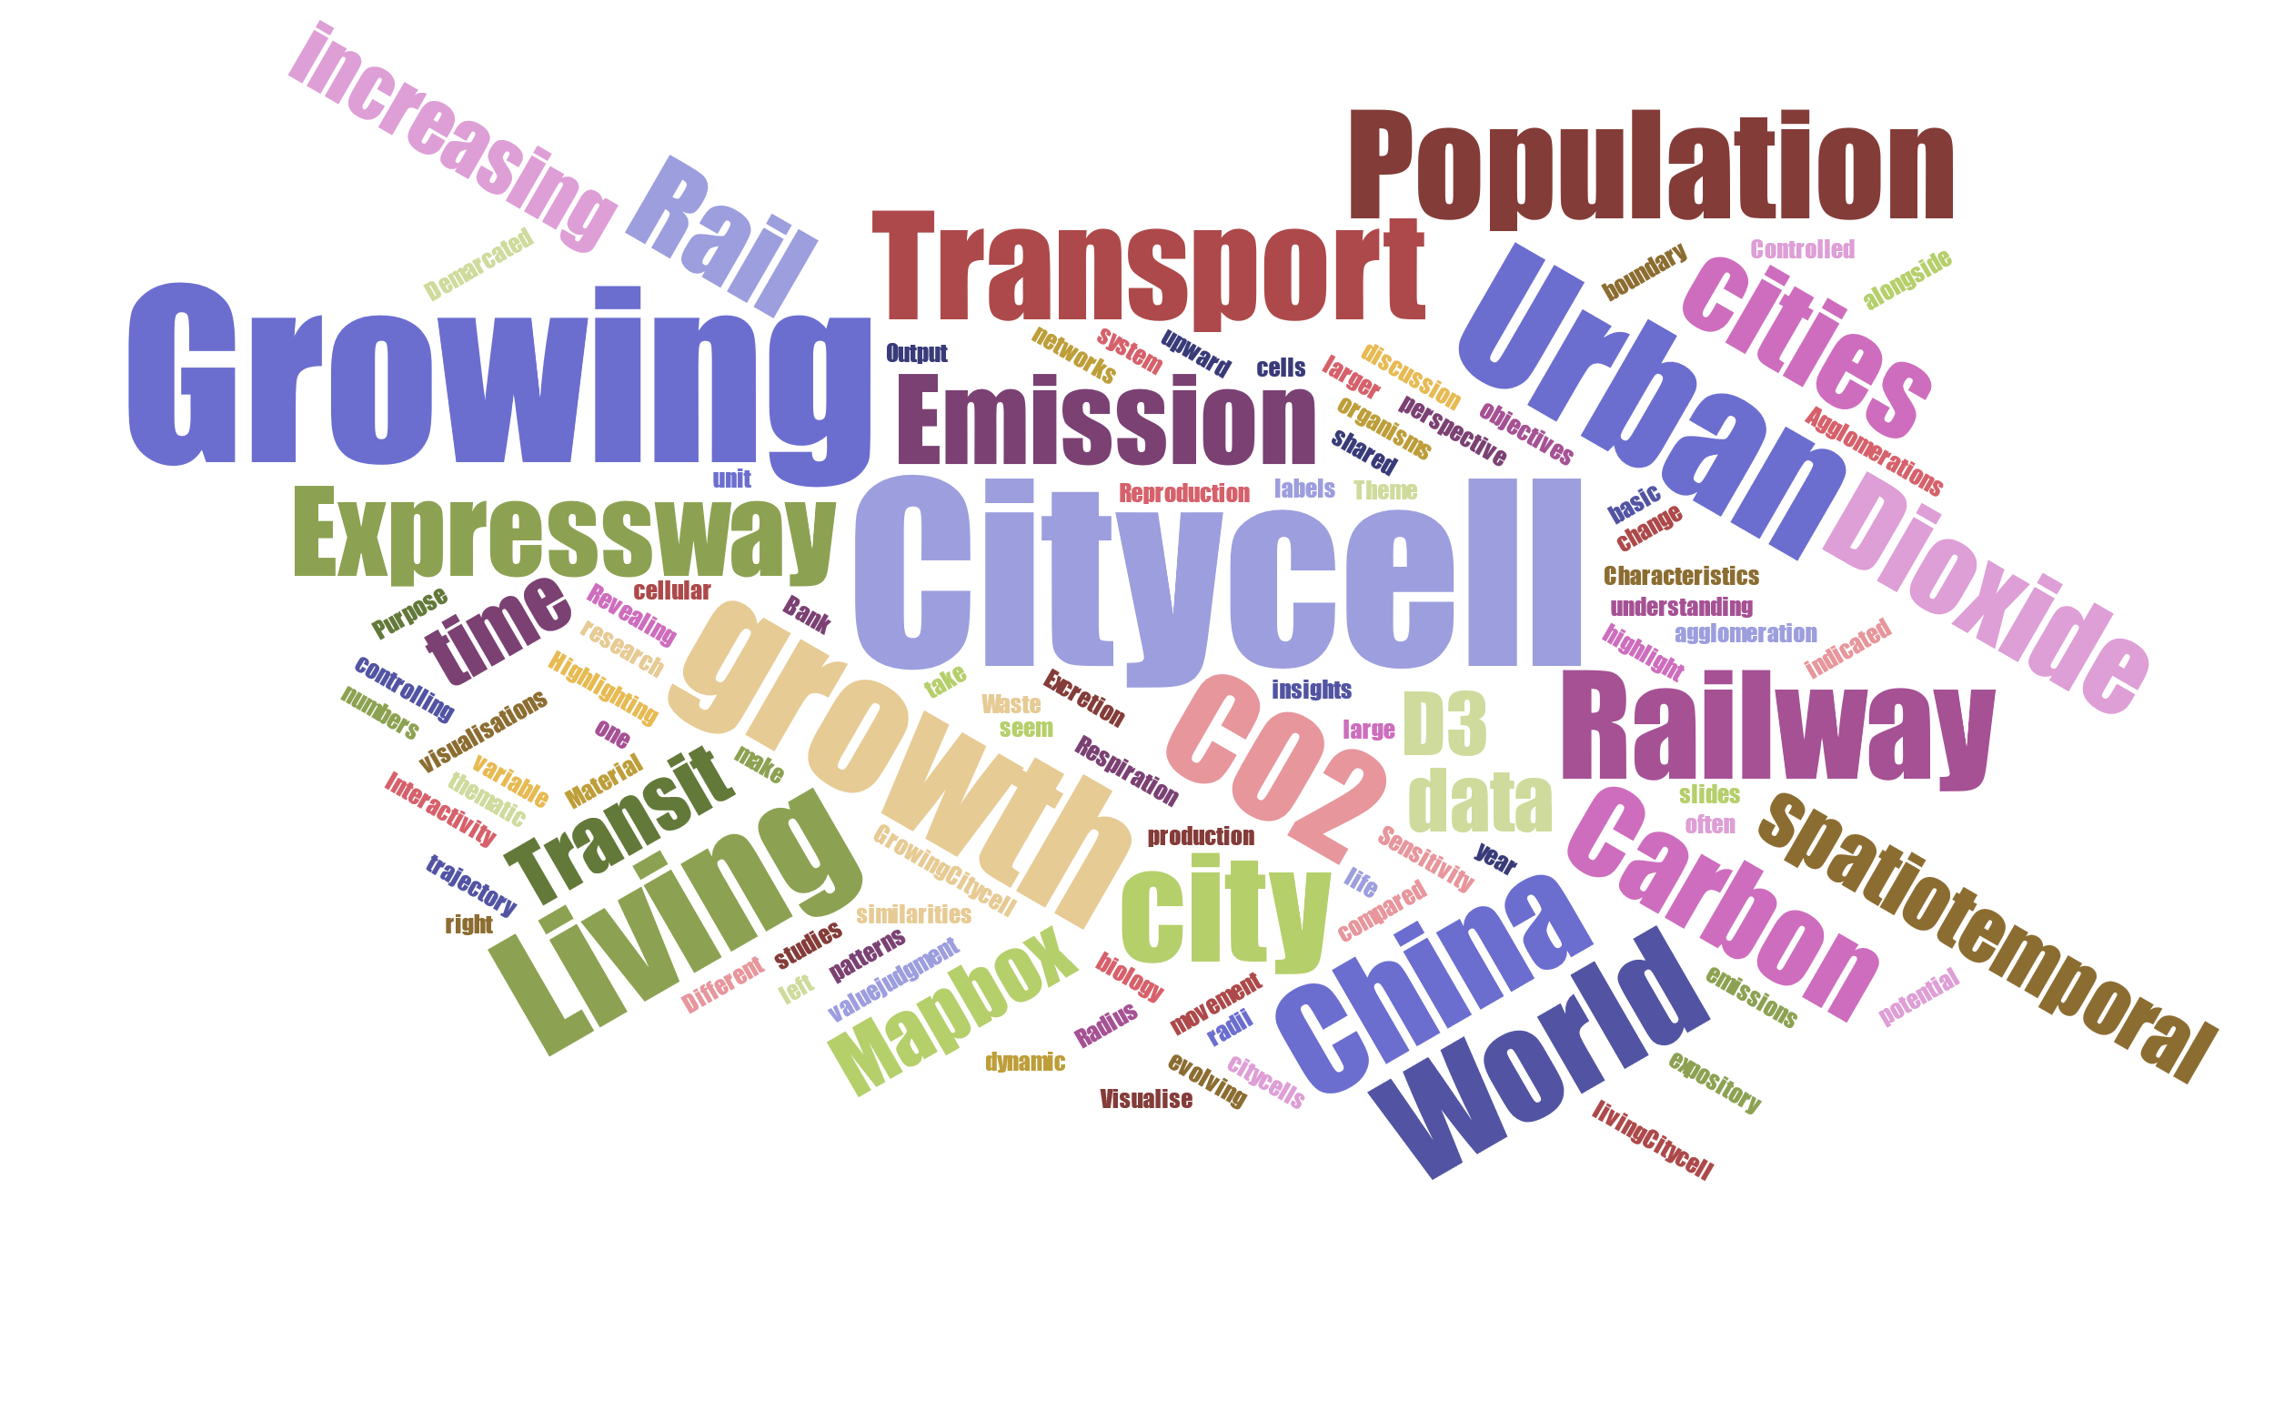

Slide 3
Table of Contents
Introduction (Tommy)
Visualisation 1: Global urbanisation trends (Tommy)
Visualisation 2: Urban agglomeration (Minghang)
Visualisation 3: Carbon dioxide emissions (Minghang and Linan)
Visualisation 4: Transportation (Yuyan)
Challenges and Solutions (Yuyan and Minghang)
Summary (Linan)

Slide 4
Growth
Reproduction
Excretion
Background of project: Conceptualisation
Characteristics of living organisms
Theme: “The Living City”
Nutrition
Respiration
Sensitivity
Movement

Slide 5
Context of project: The Living City-Cell
Cities often compared to cells – the most basic unit of life - several processes which make them seem ‘living’
Demarcated boundary
Growth processes
Accumulation of resources (nutrition)
Waste production (excretion)
Transport system (movement)
Some precedence in literature – inter-disciplinary speak
Modelled using cellular automata – units of space viewed as cells (Batty, 2005)
A Tale of Cities & Cells – “visual similarities of naturally evolved biological cells and cities” (Sahtouris, 2020)

Slide 6
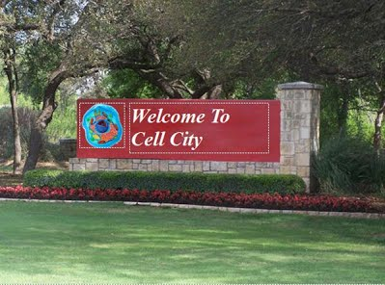
The Growing City-Cell: Demarcated boundary

Slide 7
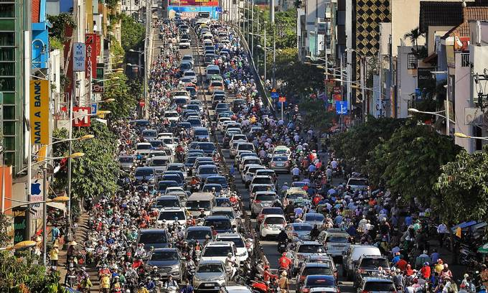
The Growing City-Cell

Slide 8
Aims of project
Highlight the similarities of a city to a cell, but also to show cities’ growth over time
Hence, the title: The Growing City-Cell
Output objectives – highlight cities as growing city-cells through:
Showing the upward growth trajectory of cities (growth)
Showing increasing large urban agglomeration patterns (accumulation of resources / nutrition)
Showing patterns of emissions over time alongside city-cell growth (excretion / waste)
Showing evolving transport networks (movement)
4 visualisations – 1 for each of the objectives

Slide 9
Broader Aims of Project
Highlighting similarities between urban studies and cellular biology
Different perspective of understanding city
Revealing the potential of shared insights on cells/cities
Not a value-judgment on this growth of the city-cell, but providing an expository take on it through thematic visualisations
Material for further discussion and research

Slide 10
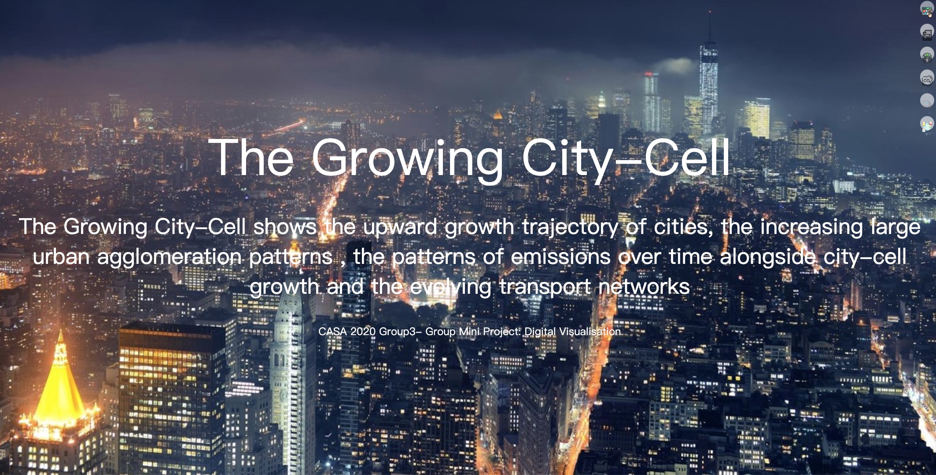
Homepage of website

Slide 11
3
TOPIC 1 – Urban Population
1
TOPIC 3 – Transportation
A Case Study in China
2
TOPIC 2 – Carbon Dioxide Emission
in the World
Outline of Topics

Slide 12
Topic one
1
Visualisation 1 - World Urbanization Percentage
Visualisation 2 - Population of Urban Agglomerations (the place with 300,000 Inhabitants or More)

Slide 13
Visualisation 1: Objectives
Demonstrate growth of city-cells on a global scale, at a country-level
Highlight the higher proportion of people living in cities over time
Visualise spatio-temporal patterns, showing change over time
Interactivity indicated
Statistical and analytical insights
Interactivity indicated once again

Slide 14
Visualisation 1: Dataset
World Bank data taken from the UN (World Bank, 2018)
Urban population as % of total population
Released by UN Population Division – World Urbanisation Prospects: 2018 Revision

Slide 15
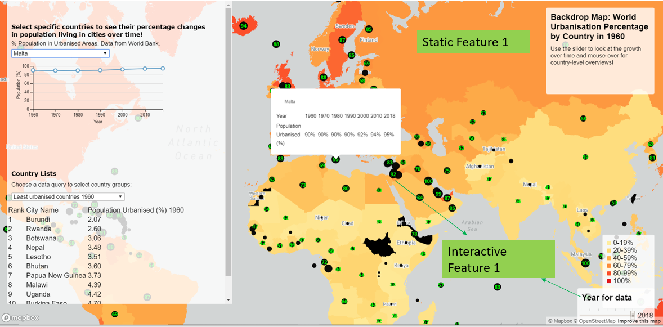
Visualisation 1

Slide 16
Visualisation 1: Features and Purposes
Static Feature 1: Backdrop choropleth map by % urbanised population of country in 1960
Purpose: Showing baseline of countries’ historic urbanisation % for comparison, to highlight the starting point for growth
Interactive Feature 1: Proportional circles representing the % of urbanised population in a country through
Radius of circle
Label on the circle
Controlled by time slider for year of data – controlling radii and labels of circles
Purpose: Showing spatio-temporal growth over time of city-cells, with increasing circles and larger numbers as one slides the slider from left to right (dynamic time variable).

Slide 17
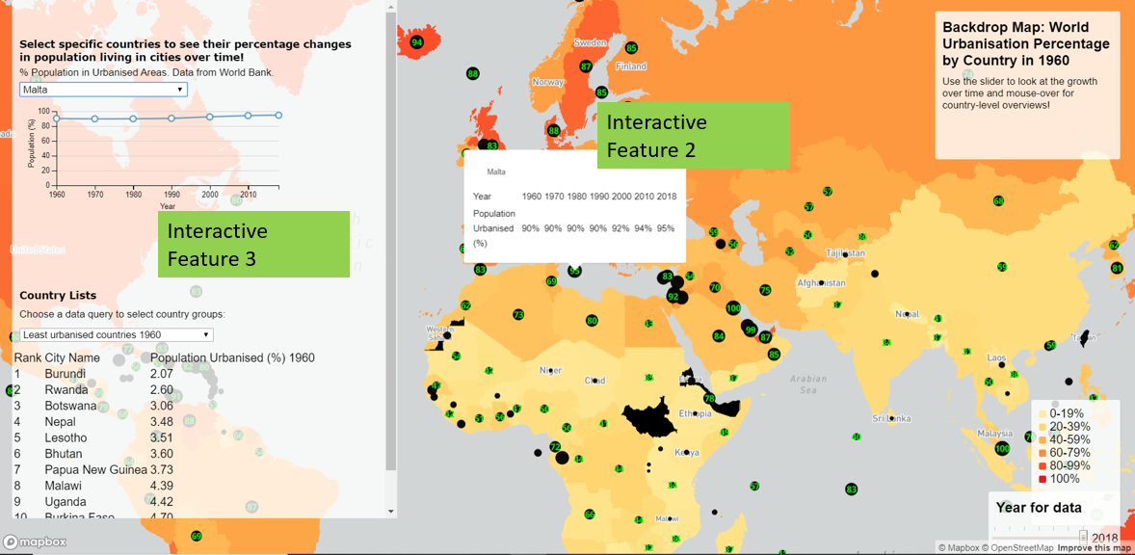
Visualisation 1

Slide 18
Visualisation 1: Features and Purposes
Interactive Feature 2: Popups when mouseover the proportional circles
Displaying a simple table of the % population urbanised and the year of data
Purpose: Showing the growth over time of city-cells clearly by individual country as opposed to a general picture for Interactive Feature 1

Slide 19
Visualisation 1: Features and Purposes
Interactive Feature 3: D3 charts/graphs
Graphs showing % change in urbanised population over time for each country, with world average included
Ranking tables showing 5 different criteria – highest/lowest urbanisation % in 1960/2018, and highest growth from 1960-2018
Purpose: statistical and analytical angle, allowing user to study changes in top 10 and bottom 10 urbanised countries over time, and look at growth rates as well

Slide 20
Visualisation 1: Challenges and Solutions
Challenge 1: Dataset pre-processing – after spatial joining in QGIS, could not be read in Mapbox
Solution: Used “refactor” function in QGIS to coerce data type into “Double”
Challenge 2: Popup issues – could not make it work/embed any text or figure
Solution: Studied instructive example of luminocity3D and learnt to apply the setHTML() method (HTML within a javascript code chunk)
Solution: Separated graph to be displayed on an outside style
Challenge 3: Styling issues – SF1 (choropleth map and legend) and IF3 (D3 graphs)
Solution: Debugging – flagging and testing repeatedly, using different styles, learnt to understand and code styles and how to nest elements within them
Solution: Learnt how to use .innerHTML() method to code the elements of the table in IF3 within a JS “if” loop

Slide 21
Topic one
1
Visualisation 1 - World Urbanization Percentage
Visualisation 2 - Population of Urban Agglomerations (the place with 300,000 Inhabitants or More)

Slide 22
Visualisation 2: Objectives
Demonstrate growth of city-cells on a global scale, based on the city with 300,000 Inhabitants or more.
Visualise the increasing large urban agglomeration patterns over time.
Visualise the population size change in these places over time.

Slide 23
Visualisation 2: Dataset
The dataset is from Department of Economic and Social Affairs, United Nations.
Population of Urban Agglomerations with 300,000 Inhabitants or more in 2018, by country, 1950-2035 (thousands).
The dataset include the data of longitude and latitude of Urban Agglomerations in each country.

Slide 24
Visualisation 2: Features and Purposes
Circle point map
Features : The radius and color of circle will varied by different population size and will change over time.
Purpose: Help people distinguish the population size of urban agglomerations in different regions.
Heatmap
Features: The color will be change by the density of urban agglomerations.
Purpose: Can intuitively reflect the density of urban agglomerations in different regions. Help users discover the aggregation patterns of urban agglomeration.

Slide 25
Visualisation 2: Features and Purposes
Features: radio button
Purpose: The Circle point map and the heatmap can switch flexibly.
Features: zoom to different countries.
Purpose: convenient for users to study the population changes over time of urban agglomerations in specific country.
Features: Popups when mouse over the circles where the urban agglomerations located.
Purpose: Demonstrate the changes of population size in different urban agglomerations over time through textual and numerical description.

Slide 26
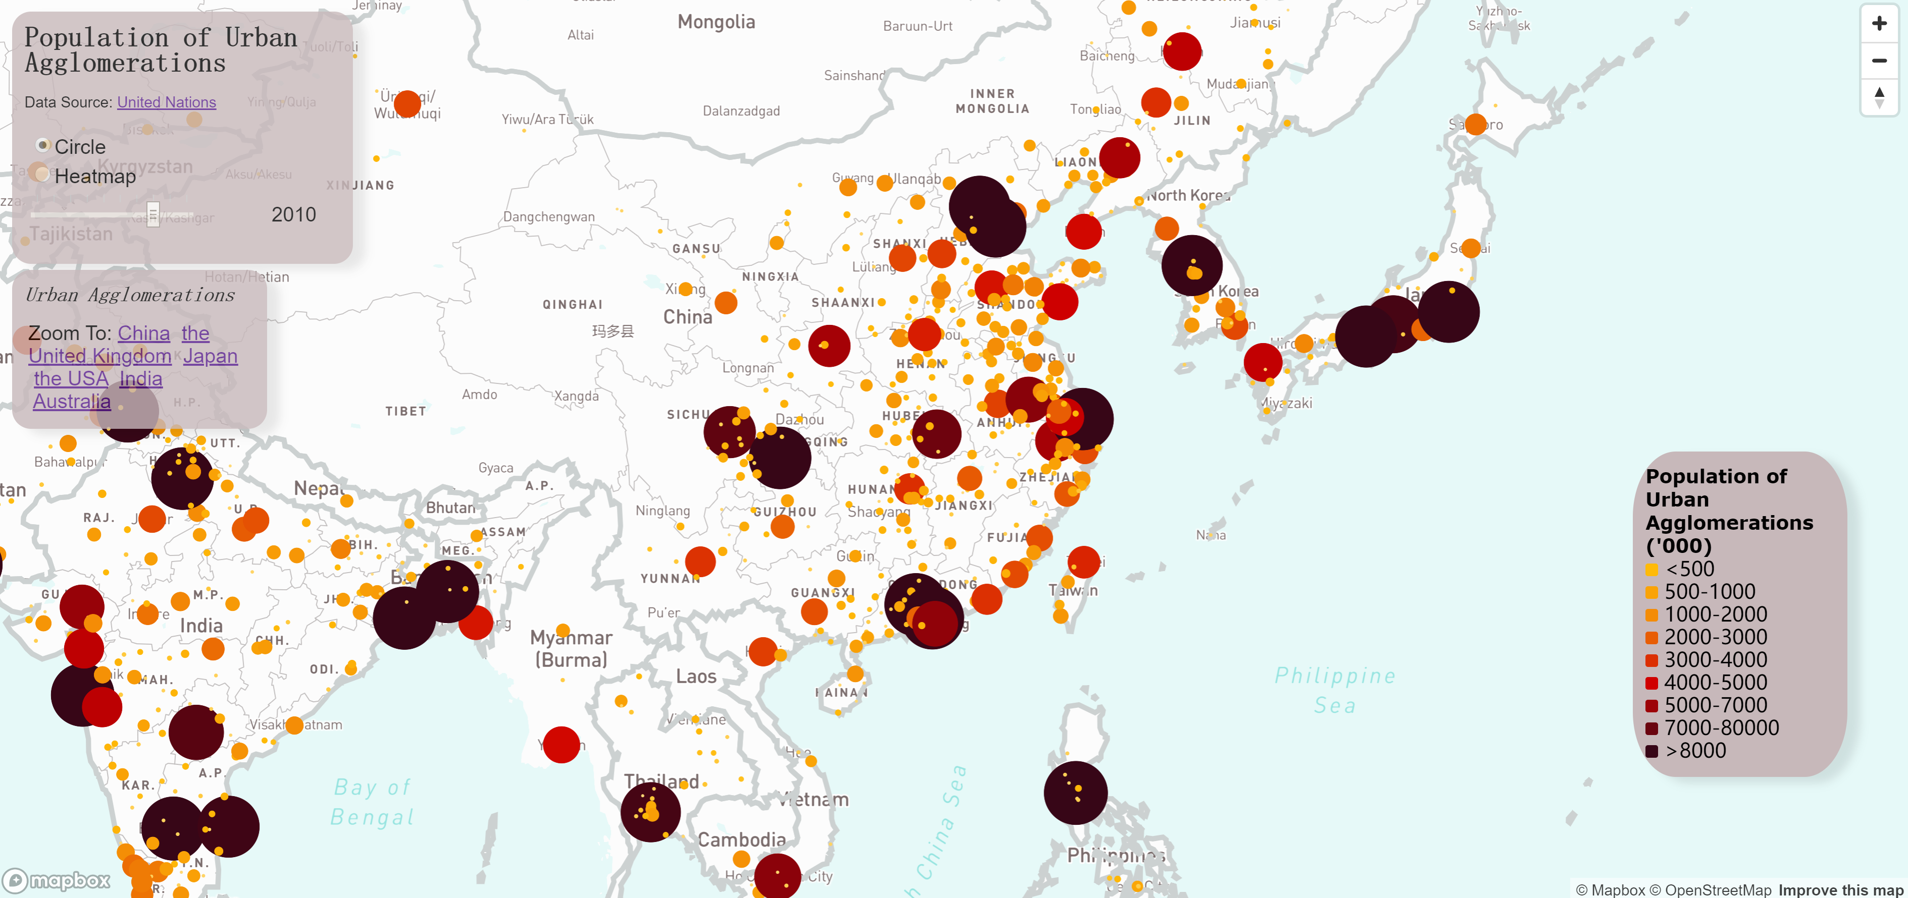
Visualisation 2: Demonstration

Slide 27
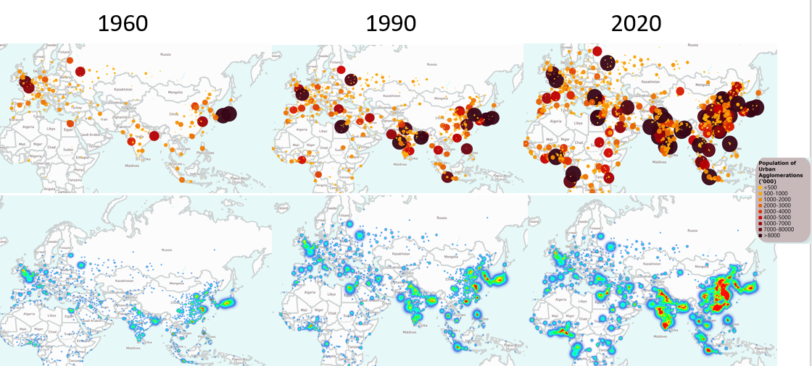
Visualisation 2: Compare

Slide 28
Topic two
2
Visualisation 3
Total Emission
Emission per capita
Emission from Transportation

Slide 29
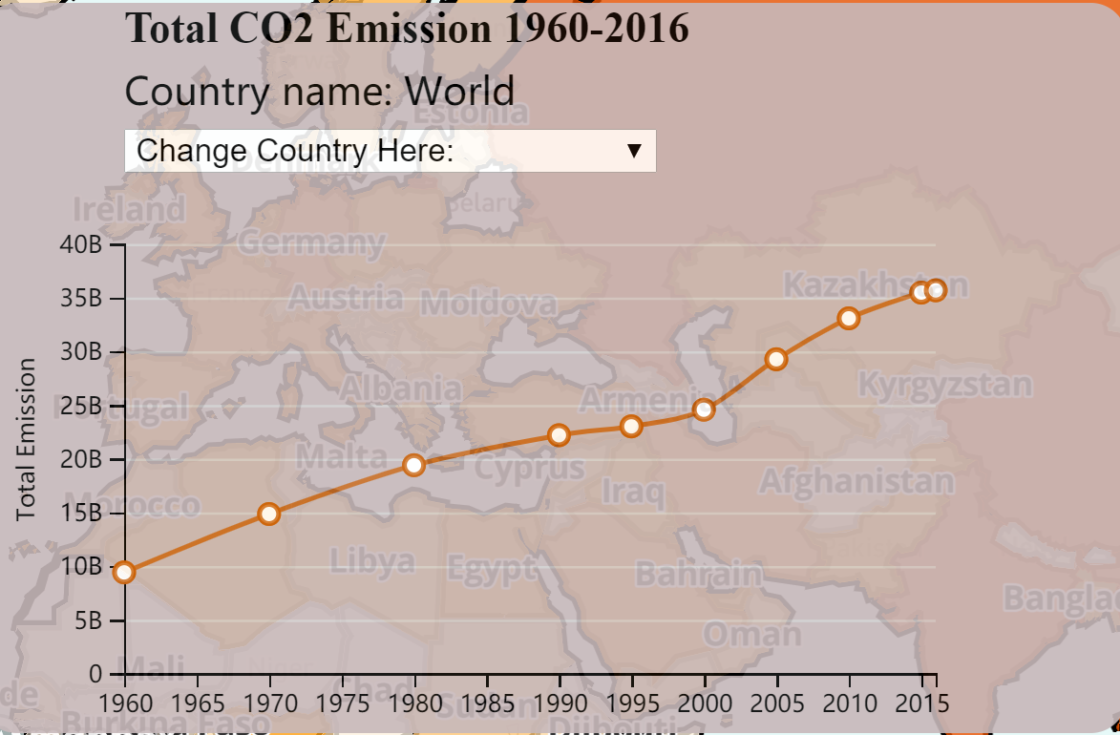
Visualisation 3: Objectives
Demonstrate growth of city-cells on a global scale at a country-level
Visualise the total CO2 emission amount over time in each country
Visualise the emission per capita over time at a country-level
Visualise the percentage of emission in transportation

Slide 30
Visualisation 3: Dataset
The dataset of Carbon Dioxide Total Emission, Emission per capita and Emission in transport sector from Our World in Data
The shapefile data is ‘Countries WGS84’ from ArcGIS Hub
This shapefile describe the country by the polygon

Slide 31
Visualisation 3: Features and Purposes
Feature: the various of color and circle size
Purpose: Using gradient color and different size to show the difference of the value which related to the emission.
Feature: Slider control the time
Purpose: The combination with slider show the change of total emission, emission per capita and proportion of emission in transportation in each country.
Feature: Combination of Highlight area and popups.
Purpose: Emphasize the boundaries of country where the mouse in; Click the mouse (or move mouse in the circle point map) can show the text and numerical information of each map.

Slide 32
Visualisation 3: Features and Purposes
Feature: Combination with line charts
Purpose: Show a vertical comparison of data changes in different countries in different years
Feature: Synchronization of map information and content of legends, popups and line charts.
Purpose: when user click the button to change the map, the content of legends, popups and line charts will also change at the same time.

Slide 33
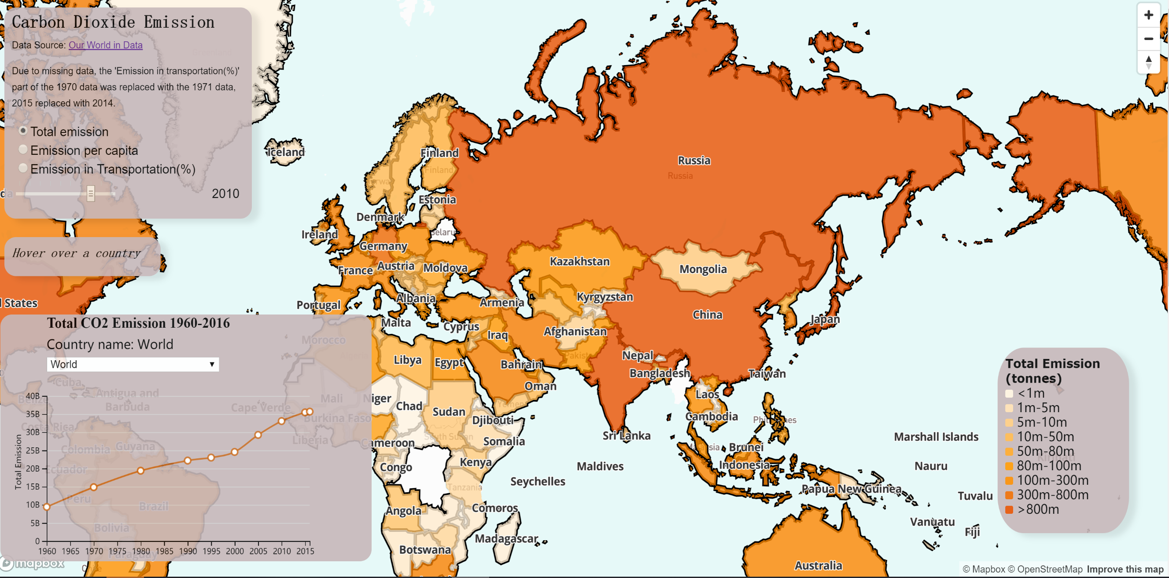
Visualisation 3

Slide 34
Topic three
3
Visualisation 4
Railway
Expressway
Urban Rail Transit System

Slide 35
A Case Study In China
Visualisation 4: Objectives
Demonstrate growth of city-cells in China, at a province-level
Visualise the length of railways
Visualise the length of expressways
Visualise the length of Urban Rail Transit System
Compare Shanghai with Hubei
Beijing
Shanghai
Hubei
Guangdong

Slide 36
Visualisation 4: Dataset
All the datasets were collected from the journal, Statistical Yearbook of China .
Data of the length of railways from 2000 to 2018
Data of the length of expressways from 2000 to 2018
Data of total length of Urban Rail Transit System from 2006 to 2018
Shapefile document of China:
http://gaohr.win/site/blogs/2017/2017-04-18-GIS-basic-data-of-China.html

Slide 37
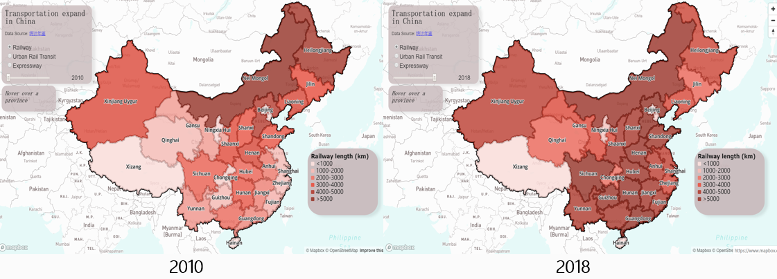
Visualisation 4: Railways

Slide 38
Visualisation 4: Features and Purposes
Heatmap shown in Mapbox
Features:
Show the data in gradient colors.
Use sliders to change years.
Purposes:
To better find how the lengths of railways vary among provinces in the same year.
To better compare how one area changes during a period.
Conclusions
The lengths of railways in most provinces increased from 2010 to 2018.

Slide 39
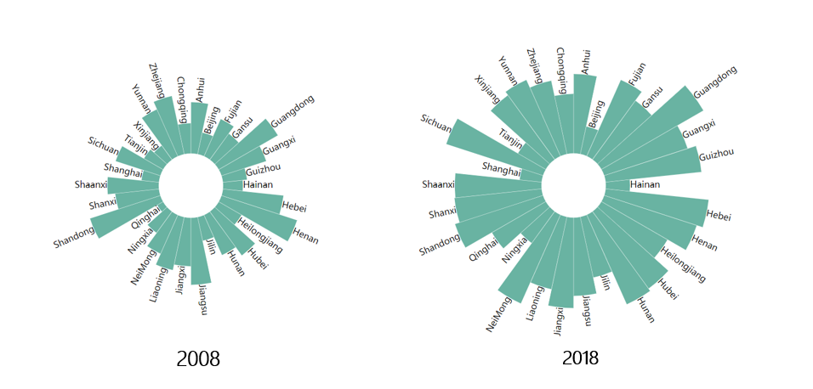
Visualisation 4: Expressways

Slide 40
Visualisation 4: Features and Purposes
Circular Barplot (D3)
Feature:
Change the traditional horizontal way, display data in a circle.
Purpose:
To better visualise the data together when there are too many columns/ rows.
Conclusions:
Nearly all provinces extended their expressway’s lines from 2008 to 2018.
The length of expressway in Shanghai, Hainan, Tanjin, and Beijing increased little.

Slide 41
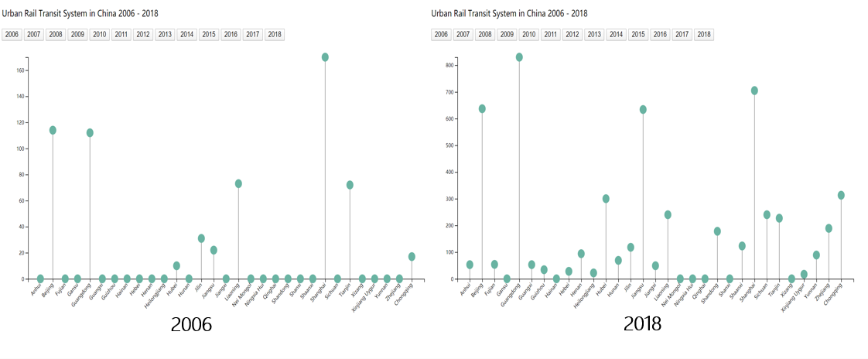
Visualisation 4: Urban Rail Transit System

Slide 42
Visualisation 4: Features and Purpose
Lollipop chart (D3)
Features:
Buttons to choose different years.
Present 31 provinces together in a clear pattern.
Purposes:
To find how provinces vary in the same year, focusing on areas rather than time.
To avoid the disadvantages of line chart and bar chart.
Conclusion:
The number of provinces having this system and the longest length increased.

Slide 43
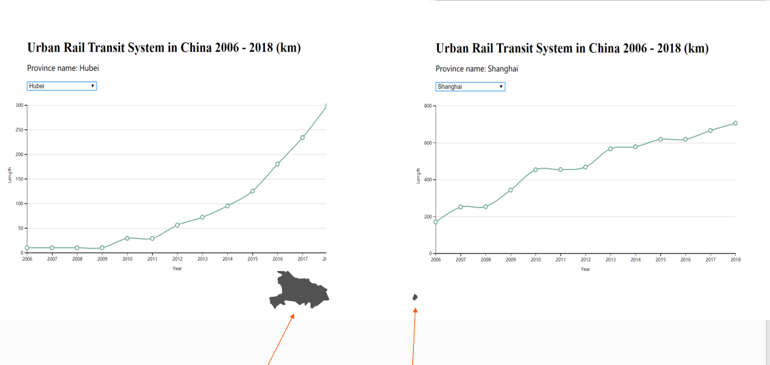
Compare: Hubei and Shanghai

Slide 44
Visualisation 4: Features and Purpose
Line chart (D3)
Features:
Buttons to choose different provinces.
Purposes:
To find how one area changed in the different years.
To compare the lengths and development between areas.
Conclusions:
Urban rail transit system in Hubei province developed more obviously.
The total length in 2018 in Hubei is much smaller than that in Shanghai.

Slide 45
D3
Challenges
&
Solutions
Mapbox

Slide 46
Challenges and Solutions: D3
Challenge 1: It seems too crowded to show 31 provinces together in x-axis in a bar chart.
Solution: Used lollipop chart and rotated the name by attr("transform", "translate(-10,0)rotate(-45)").
Challenge 2: The chart cannot be generated.
Solution: Changed the names of columns by “length+#year” rather than directly using the numbers of years when defining the “chartdata”.
Challenge 3: The chart was generated with wrong data.
Solution: Changed the index of the dataset to start with 0, which was 1 before, because I set my code ” var i = 0”.

Slide 47
Challenges and Solutions: Interactive Mapping
Challenge 1: Find the central point of polygon.
Solution: using the function of ‘centroid’ is Rstudio to find the coordinates of each country, then using the function of ‘st_as_sf’ function to convert these coordinates into shapefile document.
Challenge 2: Change of map.
Solution: using ‘setPaintProperty’ function to reset the opacity of polygon or circle. The opacity of selected map set 1 or other number >0; the opacity of other maps set 0.

Slide 48
Challenges and Solutions: Interactive Mapping
When we change the map in the visualization there are also the challenge of synchronization:
Challenge 2.1: The change of the legend.
Solution: using ‘style.opacity’ function to reset the opacity of corresponding legend as 1 and other legend as 0.
Challenge 2.2 : The change of Line charts.
Solution: Using ‘style.zIndex’ function to reset the z-index of corresponding line chart with a higher value and other line chart have lower value; using ‘style.opacity’ function to hide the uncorrelated charts.
Challenge 2.3: The synchronization of the popup content.
Solution: using ‘setLayoutProperty’ function to reset the visibility of layers. For the related layers, the visibility set ‘visible’ and other uncorrelated set ‘none’.

Slide 49
Recap
This project highlights cities as growing city-cells through demonstrating their growth, nutrition, waste and movement processes.
The upward growth trajectory of cities (growth).
The increasing large urban agglomeration patterns (accumulation of resources / nutrition).
The patterns of emissions over time alongside city-cell growth (excretion / waste)
The evolving transport networks (movement).

Slide 50
Summary
Urban population
World Urbanization Percentage: the growth of city-cells on a global scale, highlights the higher proportion of people living in cities.
Population of Urban Agglomerations: growing trend in the amount and population size of Urban Agglomerations.
A rapid and dense growing trend in the coastal regions.

Slide 51
Summary
CO2 emission
Populous countries show growing trends in total and average CO2 emission.
Transportation in developed countries contributes to an increasing proportion of emissions.
Transportation in China
Comparison of Shanghai and Hubei.
General trend in Chinese transportation networks.

Slide 52
Bibliography
Batty, M., 2005. Agents, Cells, and Cities: New Representational Models for Simulating Multiscale Urban Dynamics. Environment and Planning A: Economy and Space, 37(8), pp. 1373-1394.
Cell City Tour, 2020. The Outer Boundary. [Online] Available at: https://sites.google.com/site/cellcitytour/home/what-are-cells/the-outer-boundary [Accessed 16 May 2020].
Thien, N., 2018. HCMC officials not keen on city expansion. [Online] Available at: https://e.vnexpress.net/news/news/hcmc-officials-not-keen-on-city-expansion-3823152.html [Accessed 16 May 2020].

Slide 53
Bibliography
Sahtouris, E., 2020. A Tale of Cities and Cells, s.l.: Ethical Markets.
Smith, D., 2018. World City Populations 1950 - 2035. [Online] Available at: https://luminocity3d.org/WorldCity/#3/20.47/-29.71 [Accessed 16 May 2020].
Batty, Michael & Besussi, Elena & Chin, Nancy. (2003). Traffic, urban growth and suburban sprawl. Batty, Michael and Besussi, Elena and Chin, Nancy (2003) Traffic, urban growth and suburban sprawl. Working paper. CASA Working Papers (70). Centre for Advanced Spatial Analysis (UCL), London, UK..

Slide 54
Bibliography
World Bank, 2018. Urban population (% of total population). [Online] Available at: https://luminocity3d.org/WorldCity/#3/20.47/-29.71 [Accessed 16 May 2020]
Ritchie, H., & Roser, M. (2019). CO₂ and Greenhouse Gas Emissions. Our World in Data. [Online]. Available at: https://ourworldindata.org/co2-and-other-greenhouse-gas-emissions
World Urbanization Prospects, 2018. Urban Agglomerations. Department of Economic and Social Affairs, United Nations. [Online]. Available at: https://population.un.org/wup/Download/

